Slide 1


Oracle PL/SQL
Subquery, Format Models, Literals, and Database Objects

Slide 2
Agenda
01
02
PL/SQL Subquery
PL/SQL Format Models
03
04
Literals
PL/SQL Database Objects

Slide 3
PL/SQL Subquery

Slide 4
Subquery
It is a query within a query
A subquery is a SELECT statement within another SQL statement
The SQL statement can be SELECT, WHERE clause, FROM clause, INSERT, UPDATE, DELETE, etc.
Useful to select rows from a table with a condition that depends on a data in the same table or another table.
It allows you to use the results of inner query in the outer query.

Slide 5
Scalar Subquery
Scalar subqueries return one value, i.e., they return one row and one column
Find name, job of employees who have the same job as Jones
SELECT name, job
FROM employee
WHERE deptno = ( SELECT job FROM employee WHERE name = ‘JONES’);
Outer Query
Subquery or Inner query
name | job
JONES | MANAGER
BLAKE | MANAGER
CLARK | MANAGER
job
MANAGER
1 row in set (0.00 sec)
3 rows in set (0.00 sec)

Slide 6
Subquery That Returns a List of Values
If subquery returns more than one value, use ‘IN’ or ‘NOT IN’ between the comparison operator (=,!=) and the subquery.
‘IN’ is exactly same as '= any’
‘NOT IN’ is exactly same as '!= all’

Slide 7
Subquery That Returns a List of Values
Display name, job of employees in deptno 10 with the same job as anyone in deptno 30
SELECT name, job
FROM employee
WHERE deptno = 10 and job in (SELECT job FROM employee
WHERE deptno = 30);
Name | job
Smith | clerk
Allen | salesman
Ward | salesman
Jones | manager
Martin | salesman
Blake | manager
Turner | salesman
Adams | clerk
James | clerk
Miller | clerk
Job
Salesman
Salesman
Salesman
Manager
Salesman
Clerk

Slide 8
Subquery That Returns a Set of Values
If a subquery returns more than one value, then use ‘ANY’ or ‘ALL’ between the comparison operator (=.!=, >. <. >= <=) and the subquery.
Display information about employees who earn more than any employee in deptno 30 in the decreasing order
SELECT salary FROM employee WHERE deptno = 30;
SELECT name, job, salary, deptno FROM employee
WHERE salary > 950 ORDER BY salary DESC
Using Subqueries
SELECT name, job, salary, deptno FROM employee WHERE salary> ANY (select salary from employee WHERE deptno=30) ORDER BY salary DESC;

Slide 9
Subquery That Returns a Set of Values
Using Subqueries
‘ALL’ always considers the biggest value from the set of vaIues returned by the subquery
SELECT name, job, salary, deptno FROM employee WHERE salary> ALL (select salary from employee WHERE deptno=30) ORDER BY salary DESC;

Slide 10
Subqueries That Refer to More Than One Table
A subquery can retrieve information from more than one table.
List name, job of employees who are working in the same dept as employees located in ‘Chicago’
name | job
ALLEN | SALESMAN
WARD | SALESMAN
MARTIN | SALESMAN
BLAKE | MANAGER
TURNER | SALESMAN
JAMES | CLERK
Common column existing in both tables
SELECT name, job FROM emp WHERE deptno = (SELECT deptno FROM dept WHERE location = 'chicago');

Slide 11
Multiple Subqueries
Consider replacing with: "Multiple subqueries are used when a clause of a query contains any combination of ordinary conditions and also when it contains any number of conditions with subqueries, connected by the operators AND and OR
Find name, job of employees who have the same job as Jones
name | job | salary
JONES | MANAGER | 2975
BLAKE | MANAGER | 2850
CLARK | MANAGER | 2450
SCOTT | ANALYST | 3000
KING | PRESIDENT | 5000
FORD | ANALYST | 3000
SELECT name, job, salary FROM emp
WHERE job = (SELECT job FROM emp WHERE name = 'JONES’)
or salary >= (SELECT salary FROM emp WHERE name = 'FORD’);

Slide 12
Correlated Subquery
It is a subquery that contains a reference to the table of the outer query.
Execute the inner query repeatedly like a loop once for every row considered for selection by the outer query.
It is called ‘correlated nested query,’ because each execution of the subquery is correlated with the value of the column in one of the outer query's candidate row.

Slide 13
Correlated Subquery
Find the deptno, name, location of all depts which contain employees
SELECT * FROM dept d WHERE, EXISTS (SELECT * FROM emp WHERE deptno = d.deptno);
dept no | name | location
10 | ACCOUNTING | NEW YORK
20 | RESEARCH | DALLAS
30 | SALES | CHICAGO
Evaluates to True whenever the inner query does not return the data, i.e., matching the condition in the where clause

Slide 14
Correlated Subquery
Find the deptno, name, location of all departments which do not contain employees
SELECT * FROM dept d WHERE, NOT EXISTS (SELECT * FROM emp WHERE deptno = d.deptno);
dept no | name | location
40 | OPERATIONS | BOSTON
Evaluates to True whenever the inner query does not return the data, i.e., matching the condition in the where clause

Slide 15
PL/SQL Format Models

Slide 16
Format Models
It describes the format of datetime or numeric data stored in a character string.
It does not change the internal representation of the value in the database.
It determines how Oracle Database interprets the string, when a character string is converted into a date or number, a character literal
Format Models
Date Format Models
Number Format Models
Format Model Modifier

Slide 17
Format Models
Use a format model as an argument of TO_CHAR and TO_DATE functions to specify:
The format for Oracle to use to return a value from the database
The format for a value to store in the database
TO_NUMBER
TO_DATE
Number
Character
Date
TO_CHAR
TO_CHAR
For example:
The datetime format model for the string '17:45:29’ - 'HH24:MI:SS'
The datetime format model for the string '11-Nov-1999’ - ‘DD-MM-YYYY'
The number format model for the string '$2,304.25’ - '$9,999.99'

Slide 18
Number Format Models
TO_CHAR
Converts a value of NUMBER, BINARY_FLOAT, or BINARY_DOUBLE data type to the VARCHAR2 data type.
Example: SELECT TO_CHAR('01110' + 1) FROM dual;
TO_NUMBER
Converts a value of the CHAR or VARCHAR2 data type to the NUMBER data type
Example: Select TO_NUMBER('1234.64') from Dual;
Number Format Model
TO_BINARY_FLOAT
Converts a value of CHAR or VARCHAR2 to BINARY_FLOAT
TO_BINARY_DOUBLE
Converts a value of CHAR or VARCHAR2 to BINARY_DOUBLE

Slide 19
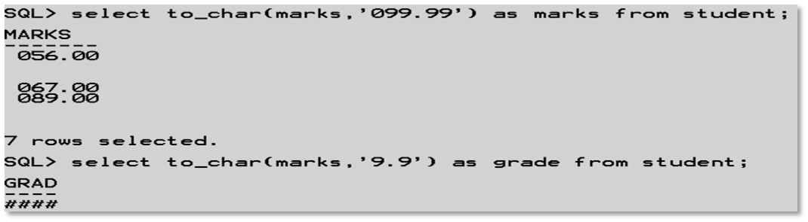
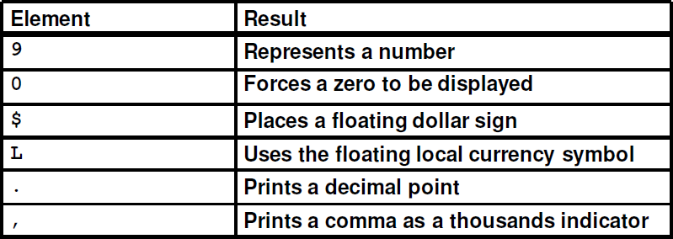
Number Format Models
With number format models, all numbers are rounded to the specified number of significant digits
If a value has more digits to the left of the decimal place than are specified in the format, then pound sign (#) replaces the values

Slide 20
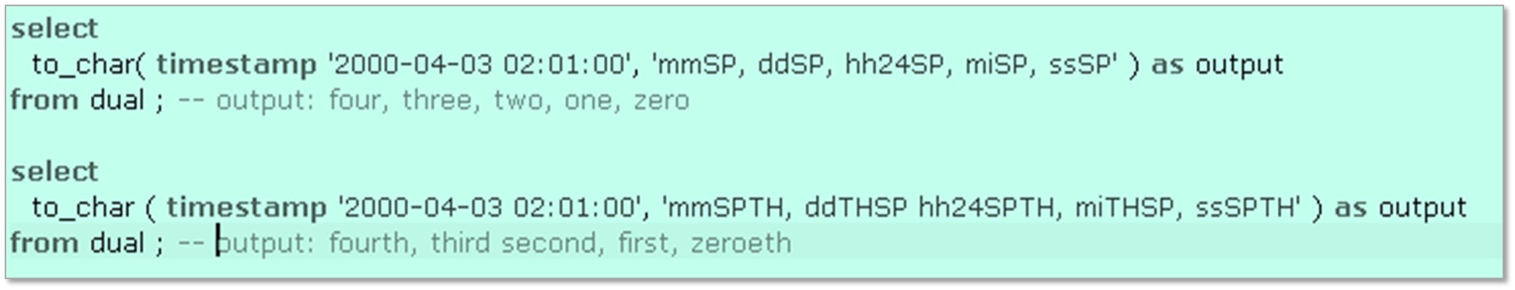
Date and Time Format Suffixes
Used to format the datetime value output. They cannot be used with input format models (e.g., with TO_DATE).
The available suffixes are:
TH - Converts numbers to ordinal numbers
SP - Converts numbers to words
SPTH - Converts numbers to ordinal words

Slide 21
Format Model Modifier
FM and FX: Two modifiers in format models for the TO_CHAR function to control blank padding and exact format checking
They can appear more than once in a format model, where each subsequent occurrence toggles the effects of the modifier.
FM ‘Fill mode’: It toggles the suppression of blank padding in character format elements like ""MONTH" and leading zeros in numeric format elements like "YYYY""
Note: FM will not, however, suppress blanks in number elements.
select TO_CHAR (SYSDATE, 'Month DD, YYYY') from dual; -- without FM 'May 05, 2016’
select TO_CHAR (SYSDATE, 'FMMonth DD, FMYYYY') from dual; -- with FM 'May 4, 2016'

Slide 22
Format Exact Modifier (FX)
Toggles exact format matching on or off
Used only in input format models (e.g., with TO_DATE)
Has no effect when used in output format models (e.g., with TO_CHAR)
When it is on, FX forces the function to perform an exact match between the format model and the character argument
select to_date( '123', 'FXyyyy' ) as a from dual ; select to_date( '123', 'FXyyyy' ) as a from dual;
*
ERROR at line 1: ORA-01862: the numeric value does not match the length of the format item

Slide 23
Literals

Slide 24
Literals
‘Literal’ refers to ‘a fixed data value’
Literal and constant value are synonymous
Literal
Text
Literal
Numeric
Literal
Datetime
Literal
Interval
Literal
Integer
Number and Floating Point
Date
Timestamp
Year to Month
Day to Second

Slide 25

Text Literals
Use the terms text literal, character literal, and string, interchangeably
' ' - two single quotation marks that begin and end text literals
Example:
'Hello‘
'ORACLE.dbs‘
'Jackie''s raincoat‘
'09-MAR-98'
q'!name LIKE '%DBMS_%%'!'
q'<'So,' she said, 'It's finished.'>'
q'{SELECT * FROM employees WHERE last_name = 'Smith';}‘ q'"name like '['"'
Q
'
[ / { </(
c
] / } / > / )
'
q

Slide 26
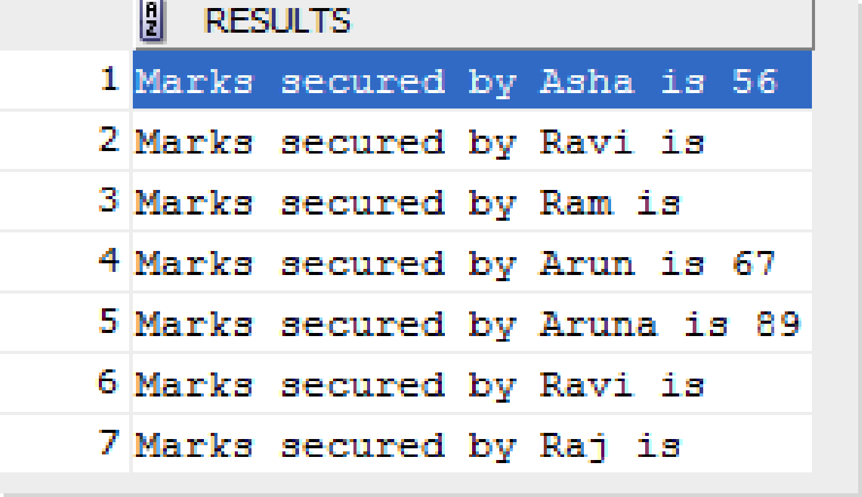
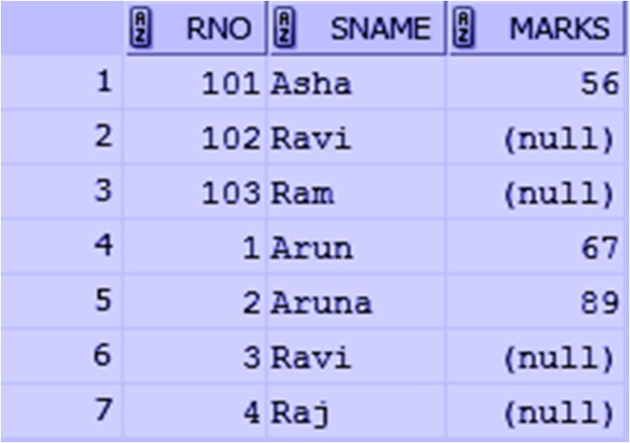
Text Literals
Select * from students
Select 'Marks secured by' || sname || 'is' || marks as results from student;

Slide 27
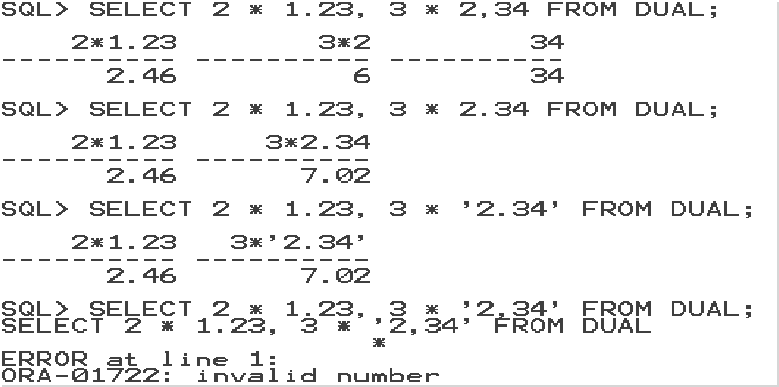
Numeric Literals
Specify fixed and floating-point numbers
Number and Floating-point Literals
Numeric Literals
Integer Literals

Slide 28
Date/Timestamp Literals
For the DATE data type, there is only one form of literal, the ANSI date literal, which uses the format, ‘YYYY-MM-DD’
DATE '-2400-01-01’ -- 2400 BC: the abacus invented in Babylonia
DATE '-500-1-1’ -- 500 BC: first known use of zero by mathematicians in ancient
-- India
DATE '+0820-01-1’ -- 820 AD: Persian mathematician Al-Khwarizmi described rudiments
-- of modern algebra (the term "algorithm" comes from
-- al-Khwarizmi's Latinized name "Algoritmi")
DATE '1947-12-16’ -- the transistor invented in USA by Shockley, Bardeen and Brattain

Slide 29
Interval Literals
An interval literal specifies a period of time in terms of years and months, or in terms of days, hours, minutes, and seconds
Interval Literals
YEAR to MONTH
Considers an interval of years to the nearest month
DAY to MINUTE
Considers an interval of days to the nearest minute
Each type contains a leading field and may contain a trailing field
Leading field: Basic unit of date or time being measured. The valid range of the leading field precision is 0 to 9, and its default value is 2
Trailing field: Smallest increment of the basic unit being considered

Slide 30
SQL Database Objects

Slide 31
Database Objects
A database object is any defined object in a database that is used to store or reference data. Examples: Tables, views, clusters, sequences, indexes, synonyms, etc.
Oracle Database Objects
Schema Objects
Non-schema Objects
Associated with a particular schema of a database
Not associated with any particular schema of a database

Slide 32
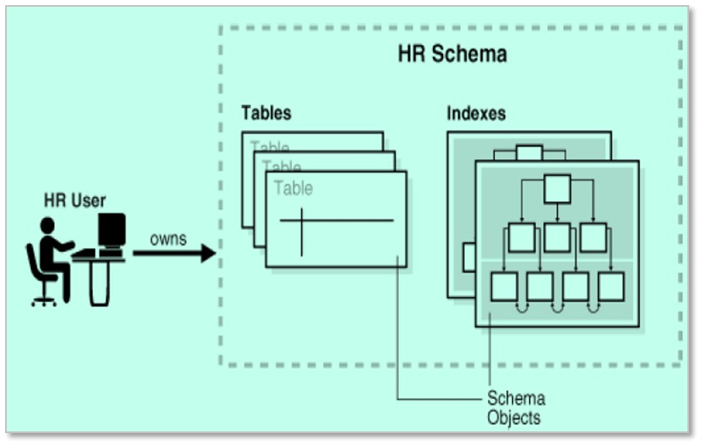
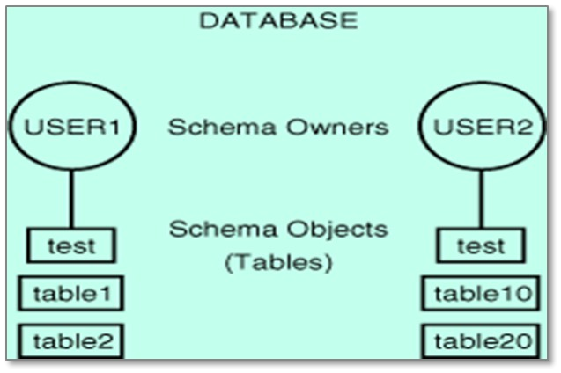
Database Schema Objects Vs. the User
The set of objects that belongs to the user ‘HR’
An account you use to connect to a database

Slide 33
How Objects Are Stored Within a Database?
Oracle stores data logically in tablespaces and physically in datafiles.
The user needs to have a quota allocated within the tablespace for creating a table. Multiple users can store their database objects in the same tablespace.
Tablespaces
Can belong to only one database at a time
Are further divided into logical units of storage
Datafiles
Can belong to only one tablespace and one database
Are repository for schema object’s data
Consist of one or more files
Database
Tablespace
Datafiles

Slide 34
Table
An object which is used to store data. It is a collection of rows and columns.
Each vertical section is called a column, and the horizontal section is called a row/record.
Rules for Naming a Table/Column:
The table name should start with an alphabet, which contains 1 to (maximum) 30 characters.
It should not contain spaces or any special characters such as except _# and 0 to 9.
A table can have minimum 1 to maximum 1000 columns.
A table can have 0 to n number of records up to our hard disk capacity.
Oracle reserved keywords and words should not be used as column names or table names.
Rules which we are following for table names are applicable for column names as well.
The numeric precision for a column must be 1 to 38.

Slide 35
Cluster, Constraints, Indexes, and Synonyms
A cluster stores related rows of different tables at the same physical location based on the common column (cluster key) of different tables
Constraints are rules applied to the data of a database in order to allow the storage of legal instances into the database
Indexes are used in Oracle to provide quick access to rows in a table. An index creates an entry for each value that appears in the indexed columns of a table
A synonym is simply an alias of Oracle Database objects like table, view, etc. It requires no storage other than its definition in the data dictionary

Slide 36
Views, Sequences, Database Link, and Triggers
A view is a virtual table that does not physically exist. Rather, it is created by a query joining one or more tables, referred to as base tables of the views
A sequence is used to generate a number sequences. This can be useful when you need to create a unique auto number to act as a primary key
A database link allows you to reference objects in a remote database/another database. When accessing a remote object over a database link, the local database acts as an Oracle client. Here, the another database need not be an Oracle database
Database triggers are procedures that are implicitly executed when an INSERT, UPDATE, or DELETE statement is issued against the associated table

Slide 37
Non-schema Objects
Objects that are not contained in a schema
Other types of objects stored in the database
Can be created and manipulated with SQL
Contexts
Directory
Edition
Restore Points
Create a namespace for a context
Is a database object that is an alias for a file system pathname
Is effectively a copy of the entire original database
Enable us to rewind the database back in time to correct any problems caused by logical data corruption or user errors
Associate the namespace with the externally created package that sets the context
Used to store LOBs
Roles
A set or group of privileges that can be granted to users or another role. This is a great way for database administrators to save time and effort
Rollback Segments
Objects that Oracle Database uses to store data necessary to reverse, or undo, changes made by transactions
Tablespace
Is a storage location where the actual data of underlying database objects can be kept
Users
Account you use to connect to a database

Slide 38
Database Object Names and Qualifiers

Slide 39
Database Object Naming Rules
Every database object has a name.
In a SQL statement, you represent the name of an object with a quoted/non-quoted identifier. Names must be from 1 to 30 characters long with these exceptions:
Names of databases are limited to 8 characters.
Names of database links can be as long as 128 characters.
Names cannot contain quotation marks. Names are not case-sensitive.
Non-quoted identifiers must begin with an alphabetic character of database character set. Quoted identifiers can begin with any character.
Names can only contain alphanumeric characters from database character set and the characters _, $, and #. But keep the usage of $ and # minimum.
If your database character set contains multi-byte characters, It is recommended that each name for a user or a role contains at least one single-byte character.
Names of database links can also contain periods (.) and ampersands (&).
A name cannot be Oracle’s reserved keyword, this includes words followed by an asterisk (*) which are ANSI reserved words. DUAL should not be used as a name for an object or part.

Slide 40
Database Object Naming Rules
A name must be unique across its namespace.
Schema objects share one namespace
Tables
Views
Sequences
Private Synonyms
Stored Functions
Packages
Snapshots
Indexes
Constraints
Clusters
Schema objects have their own namespace
Database Triggers
Private Database Links

Slide 41
Object Naming Guidelines
Use a full, descriptive, pronounceable name (or well-known abbreviations)
Use consistent naming rules
Use the same name to describe the same entity or attribute across tables

Slide 42
Quiz

Slide 43
Quiz 1
In a PL/SQL block, a variable is declared as NUMBER without an initial value. What will its value be when it is first used in the executable section of the PL/SQL block?
A
Null
B
0
C
Results in a compilation error
D
An exception will be raised

Slide 44
Answer 1
In a PL/SQL block, a variable is declared as NUMBER without an initial value. What will its value be when it is first used in the executable section of the PL/SQL block?
A
Null
B
0
C
Results in a compilation error
D
An exception will be raised

Slide 45
Quiz 2
Which physical file contains the name and location of datafiles?
A
Parameter File
B
Redo log file
C
Control file
D
Password File

Slide 46
Answer 2
Which physical file contains the name and location of datafiles?
A
Parameter File
B
Redo log file
C
Control file
D
Password File

Slide 47
Quiz 3
What is UNISTR(x) used for?
A
Converts the characters in x to the national language character set
B
Converts the characters in x to the national language character set (VARCHAR)
C
Converts the characters in x to the national language character set (CHAR)
D
Converts the characters in x to the national language character set (NCHAR)

Slide 48
Answer 3
What is UNISTR(x) used for?
A
Converts the characters in x to the national language character set
B
Converts the characters in x to the national language character set (VARCHAR)
C
Converts the characters in x to the national language character set (CHAR)
D
Converts the characters in x to the national language character set (NCHAR)

Slide 49
Quiz 4
Maximum number of column a table can have in Oracle?
A
500
B
1000
C
2000
D
100

Slide 50
Quiz 4
Maximum number of column a table can have in Oracle?
A
500
B
1000
C
2000
D
100

Slide 51
Quiz 5
SQL views can be used to hide:
A
Columns and rows only.
B
complicated SQL syntax only.
C
both of the above can be hidden by an SQL view.
D
None of the above is correct.

Slide 52
Answer 5
SQL views can be used to hide:
A
Columns and rows only.
B
complicated SQL syntax only.
C
both of the above can be hidden by an SQL view.
D
None of the above is correct.

Slide 53

India: +91-7847955955
US: 1-800-216-8930 (TOLL FREE)
sales@intellipaat.com
24/7 Chat with Our Course Advisor
Notes:
Thank you!

